Slide 1

WELCOME
Santa Cruz County
Small Water Systems Forum
November 8, 2022
  Drinking Water Updates
  Revised Total Coliform Rule (rTCR) Sampling Guidance
  SB 552 updates

Slide 2
Drinking Water Updates

Slide 3
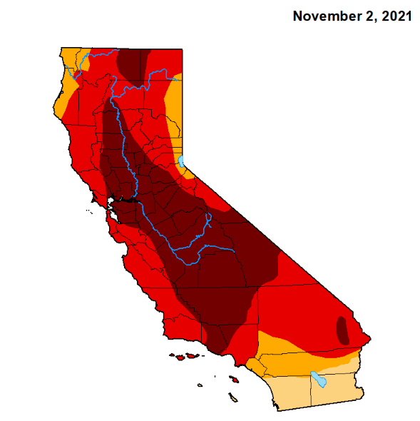
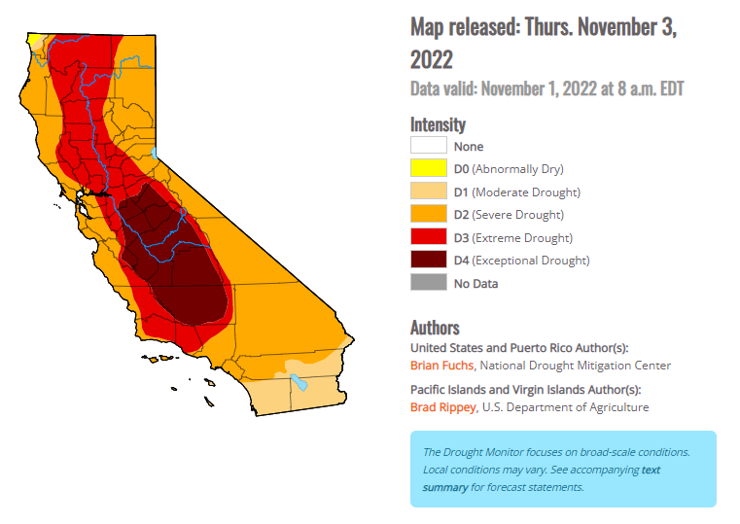
Drought Update

Slide 4
Drinking Water Updates, continued
  State Water Resources Control Board (State Water Board) List of Failing Systems
    https://www.waterboards.ca.gov/drinking_water/certlic/drinkingwater/2022.html
  PFAS Monitoring Orders issued by State Water Board 11/03/22
    Quarterly PFAS sampling required for water sources close to sites where PFAS have been detected in previous monitoring (distance not specified)
  Monthly production reporting for state small water systems due January 15, 2023
  Chromium-6 MCL still under review

Slide 5
Revised Total Coliform Rule (rTCR) Sampling Guidance

Slide 6
Key things to remember when sampling for bacteria
  Be prepared to take repeat samples.
  Sample according to your Bacteriological Sample Siting Plan (BSSP).
  If you want it to count, you must label it properly!

Slide 7
What is wrong here?
Other
Collected sample is absent for bacteria (TC and EC)

Slide 8
What is wrong here?
Other
Collected sample is absent for bacteria (Total Coliforms and E. coli)
Routine
The operator did not label the sample as routine. If a sample marked routine was not collected that month, this system would receive a citation for failure to collect a routine sample.

Slide 9
What is wrong here?
Routine
Routine is Total Coliform (TC) positive
Repeat:
Original Site

Slide 10
What is wrong here?
Routine
Routine is Total Coliform (TC) positive
Repeat:
Original Site
Repeat:
Upstream Site
Repeat:
Down-stream Site
Repeat:
All Sources
The operator did not collect a full repeat sample set as defined in the BSSP. Even though a repeat was absent for bacteria, this would put them out of compliance with their sampling plan and would result in a citation and a required site assessment

Slide 11
Scenario 1:
Routine
Routine is Total Coliform (TC) positive
Repeat:
Original Site
Repeat:
Upstream Site
Repeat:
Down-stream Site
Repeat:
All Sources
Repeat sample set is fully absent for bacteria, suggesting a false positive on the routine sample (or minor contamination which is no longer present). No further action is required. Operator is in full compliance with sampling requirements.

Slide 12
Scenario 2:
Routine
Routine is TC positive
Repeat:
Original Site
Repeat:
Upstream Site
Repeat:
Down-stream Site
Repeat:
All Sources
Two of the repeat sample locations are positive for TC, indicating an issue is present in the system. Within 24 hours, county staff must be notified. There is no public notification requirement for TC detections, however a water system assessment is required.

Slide 13
Scenario 3:
Routine
Routine is TC positive
Repeat:
Original Site
Repeat:
Upstream Site
Repeat:
Down-stream Site
Repeat:
All Sources
All of the repeat sample locations are positive for TC, indicating an issue with the source(s). In addition to the requirements previously discussed, systems that provide continuous disinfection will need to collect 3 consecutive source samples that are absent for bacteria.

Slide 14
Scenario 4:
Routine
Routine is TC positive
Repeat:
Original Site
Repeat:
Upstream Site
Repeat:
Down-stream Site
Repeat:
All Sources
Repeat:
Alternate Location
In the repeat sample set, only the original location is positive for TC. This indicates an issue with the location. The operator should request that the location be invalidated and then collect an alternate sample to replace the original location.

Slide 15
Scenario 5:
Routine
Routine is E. coli (EC) positive
Repeat:
Original Site
Repeat:
Upstream Site
Repeat:
Down-stream Site
Repeat:
All Sources
In the repeat sample set, detection of EC is confirmed. This situation threatens the health of consumers and County Staff should be notified immediately. A Boil Water Notice must be posted and remain in place until two (2) consecutive bacteria samples, taken at least 24 hours apart, are absent for bacteria.

Slide 16
SB 552 Updates: Drought Planning for Small Water Suppliers and Rural Communities

Slide 17

Senate Bill 552
Slide credit:
Michelle Frederick, P.E.
Supervising Engineer
SWRCB – Division of Drinking Water
Partners:
Julie Ekstrom, Department of Water Resources (DWR)
Orit Kalman, Sac State – Consensus and Collaboration (Sac State)

Slide 18
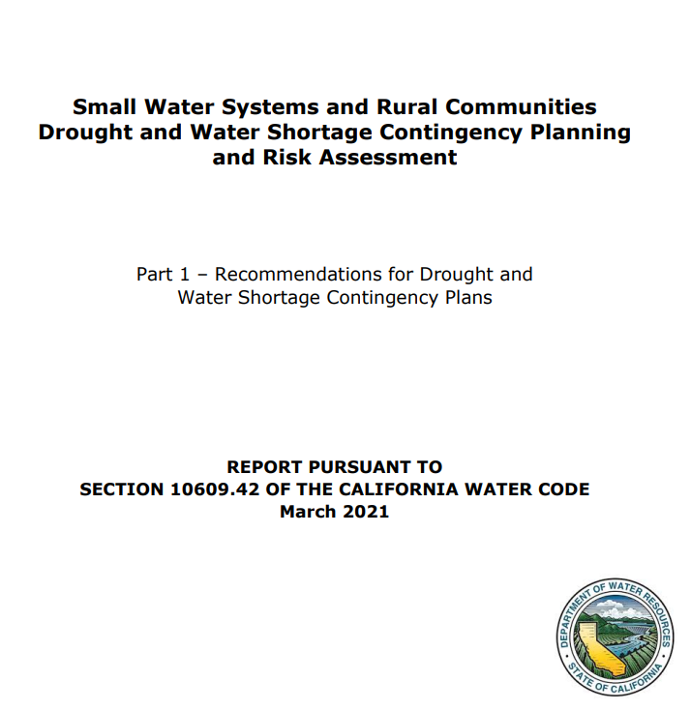
Where did SB 552 come from?
2012-2016 Drought → AB 1668
DWR hosted process focused on small water systems and rural communities (CDAG: County Drought Advisory Group)
  Risk Scoring and Tool
  Develop recommendations on how to cover them with water shortage contingency plans
Recommendations passed as SB 552

Slide 19
SB 552 Summary: New Requirements
Small Suppliers*
Counties
State
1,000-2,999 connections + schools: Water shortage contingency plan
Create a standing Drought & Water Shortage Task Force for state smalls and domestic wells (or similar alternative)
Drought Risk Tool (small suppliers, private supplied homes and state small systems 5-15 connections)
All Small Suppliers: Supply conditions annual reporting
Establish Standing Interagency Drought & Water Shortage Task Force (with local government and stakeholder membership)
Develop Water Shortage Plan (and assessment) for state smalls water systems (SSWS) and domestic wells (DW) in the county or similar alternative
All Small Suppliers: Drought resiliency standards – infrastructure upgrades
<1,000 connections: Drought assessment/element for 15-999 connections into Emergency Response Plan
*Includes community water suppliers serving less than 3,000 connections and 3,000 Acre Feet. Includes non-transient, non-community water systems serving schools; excludes those covered under current Urban Water Management Plan
Notes:
The report recommended that all small community water systems be required to develop an Emergency Response Plan and small systems with 1,000 to 2,999 connections also be required to complete an abridged Water Shortage Contingency Plan and small systems with less than 1,000 connections be required to complete a Drought Supply Assessment. Today’s presentation is guided by DWR’s Proposed Water Shortage Contingency Plan Components for Small Systems.
DWRs report is available through their County Drought Planning website https://water.ca.gov/Programs/Water-Use-And-Efficiency/2018-Water-Conservation-Legislation/County-Drought-Planning
Reference SB 552 (Hertzberg)
This bill would require small water suppliers, as defined, and nontransient noncommunity water systems that are schools, no later than December 31, 2022, to develop and maintain an abridged Water Shortage Contingency Plan that includes specified drought-planning elements.
“Small water supplier” means a community water system serving 15 to 2,999 service connections, inclusive, and that provides less than 3,000 acre-feet of water annually.

Slide 20
SB 552 Summary: New Requirements
Small Suppliers*
1,000-2,999 connections + schools: Water shortage contingency plan
All Small Suppliers: Supply conditions annual reporting
All Small Suppliers: Drought resiliency standards – infrastructure upgrades
<1,000 connections: Drought assessment/element for 15-999 connections into Emergency Notification Plan or Emergency Response Plan
Notes:
The report recommended that all small community water systems be required to develop an Emergency Response Plan and small systems with 1,000 to 2,999 connections also be required to complete an abridged Water Shortage Contingency Plan and small systems with less than 1,000 connections be required to complete a Drought Supply Assessment. Today’s presentation is guided by DWR’s Proposed Water Shortage Contingency Plan Components for Small Systems.
DWRs report is available through their County Drought Planning website https://water.ca.gov/Programs/Water-Use-And-Efficiency/2018-Water-Conservation-Legislation/County-Drought-Planning
Reference SB 552 (Hertzberg)
This bill would require small water suppliers, as defined, and nontransient noncommunity water systems that are schools, no later than December 31, 2022, to develop and maintain an abridged Water Shortage Contingency Plan that includes specified drought-planning elements.
“Small water supplier” means a community water system serving 15 to 2,999 service connections, inclusive, and that provides less than 3,000 acre-feet of water annually.

Slide 21
Small Water Suppliers: (15-2,999 connections)
Drought Resiliency Measures
Implement drought resiliency measures, subject to funding availability:
  Detect production well groundwater levels - Jan 1, 2023
  Mutual aid organization membership - Jan 1, 2023
  Continuous operation during power failures - Jan 1, 2024
  Backup source of water supply or a water system intertie - Jan 1, 2027
  Meter each service connection and monitor water loss - Jan 1, 2032
  Meet fire flow requirements - Jan 1, 2032
Notes:
Needs Assessment looked at costs and we are working with DFA to think how we can respond to these.

Slide 22
SB 552 Summary: New Requirements
Counties
Create a standing Drought & Water Shortage Task Force for state smalls and domestic wells (or similar alternative)
Develop Water Shortage Plan (and assessment) for state smalls and domestic wells in the county (or similar alternative)
DWR/SWB collaborating to support these efforts
Notes:
The report recommended that all small community water systems be required to develop an Emergency Response Plan and small systems with 1,000 to 2,999 connections also be required to complete an abridged Water Shortage Contingency Plan and small systems with less than 1,000 connections be required to complete a Drought Supply Assessment. Today’s presentation is guided by DWR’s Proposed Water Shortage Contingency Plan Components for Small Systems.
DWRs report is available through their County Drought Planning website https://water.ca.gov/Programs/Water-Use-And-Efficiency/2018-Water-Conservation-Legislation/County-Drought-Planning
Reference SB 552 (Hertzberg)
This bill would require small water suppliers, as defined, and nontransient noncommunity water systems that are schools, no later than December 31, 2022, to develop and maintain an abridged Water Shortage Contingency Plan that includes specified drought-planning elements.
“Small water supplier” means a community water system serving 15 to 2,999 service connections, inclusive, and that provides less than 3,000 acre-feet of water annually.

Slide 23
SSWS & Domestic Well Activities
Needs Assessment/DWR Data Collection & Tool Development
DWR Support for Counties for Planning
SWB Developed Regional Funding SSWS/DW Programs

Slide 24
SB 552 Summary: New Requirements
DWR Drought Risk Tool (small suppliers, private supplied homes and state small systems 5-15 connections)
Establish Standing Interagency Drought & Water Shortage Task Force (with local government and stakeholder membership)
State

Slide 25
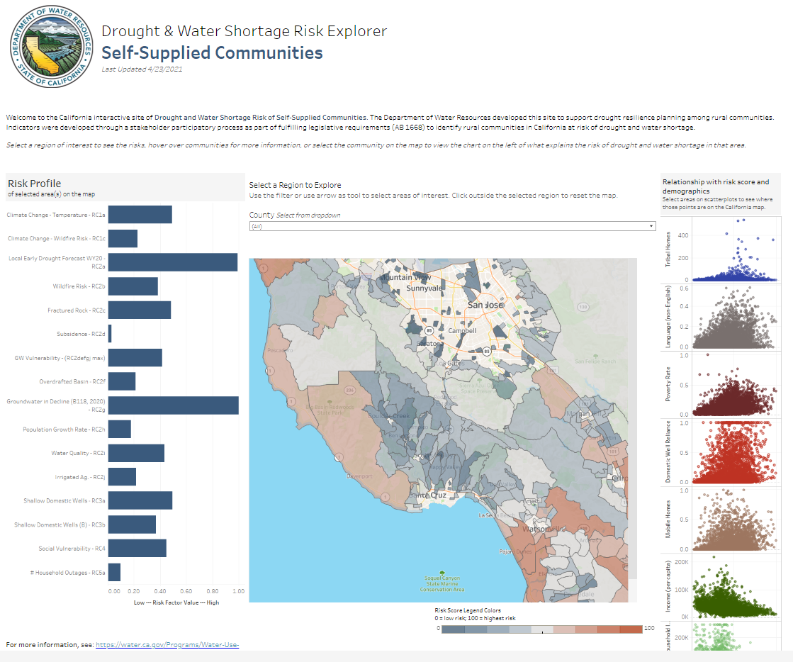
DWR Drought Risk Tool
https://water.ca.gov/Programs/Water-Use-And-Efficiency/SB-552

Slide 26
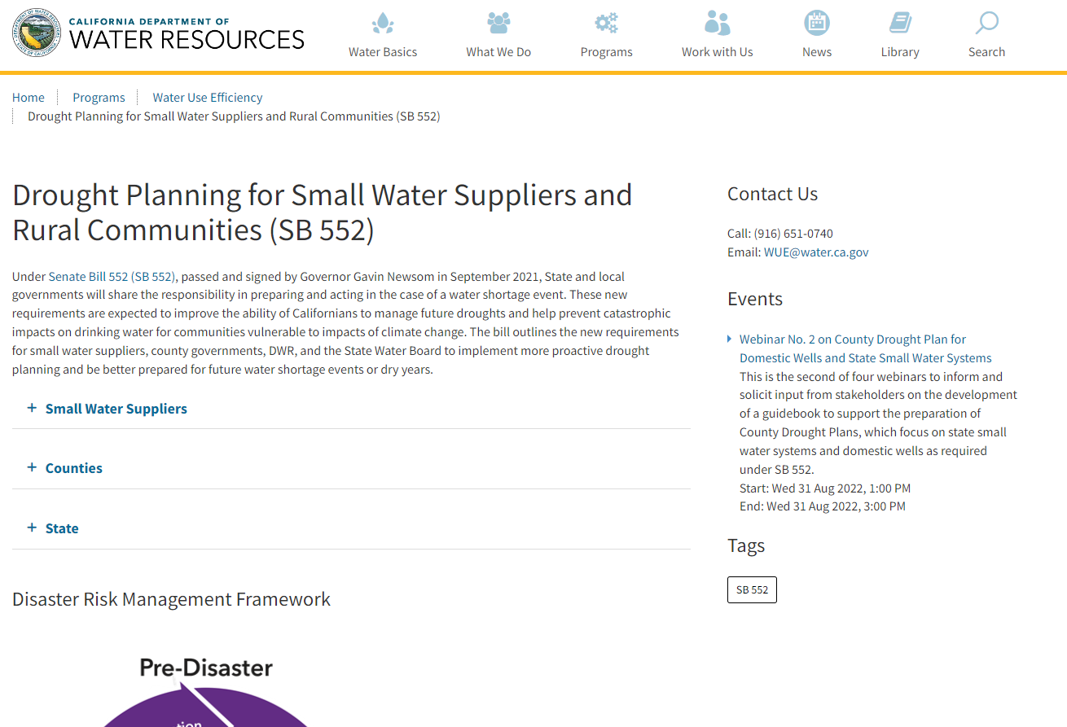
DWR Collaboration
https://water.ca.gov/Programs/Water-Use-And-Efficiency/SB-552

Slide 27
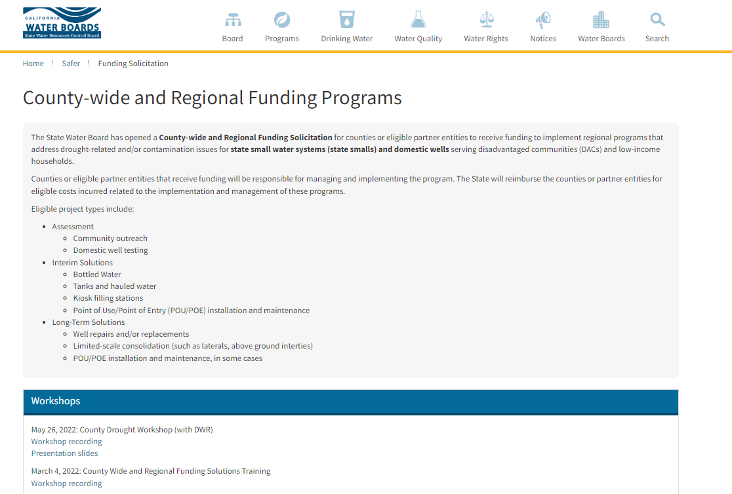
DFA Funding for SSWS/DWs
https://www.waterboards.ca.gov/safer/funding_solicitation.html

Slide 28
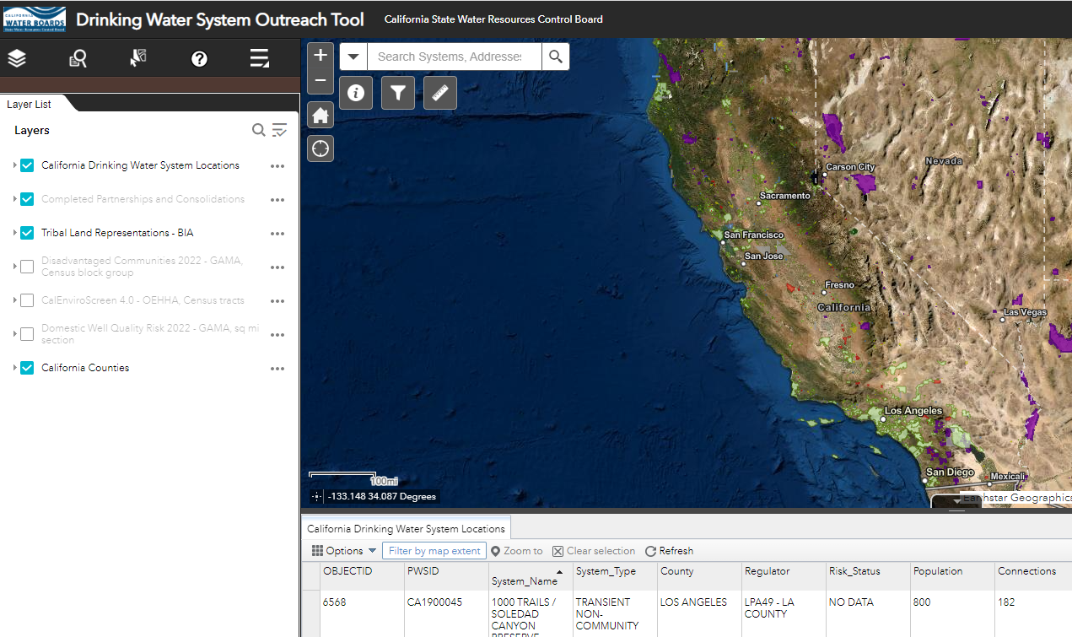

Water System Outreach Partnership Tool
https://bit.ly/3QK8Wb9

Slide 29
Key Points: SB 552 Requirements for Small Water Systems
  Self-reporting expected for resiliency measures taken (EAR or other form of reporting to County/State)
  Join CalWARN or other mutual aid organization!
  More guidance and templates to be provided by State Water Board/DWR for water shortage contingency plans, drought assessment elements of Emergency Notification Plans
  Approximately 1/3 of water systems in California only have one source- pursue interties between water systems if feasible

Slide 30
Thank You!

